Slide 1

Title – SafeHerNet
By Team
Emergers
1.A Ramya
2.Ramya Devi K
3.Sudha SP
4.Meenakshi G
Women are more active online than ever—learning, working, leading.
But face harsher risks: harassment, identity theft, deepfakes, bullying.
8 in 10 women avoid reporting online abuse due to stigma.
Fear reduces digital confidence and silences voices.
Current tools are too technical, reactive, and not women-focused

Slide 2
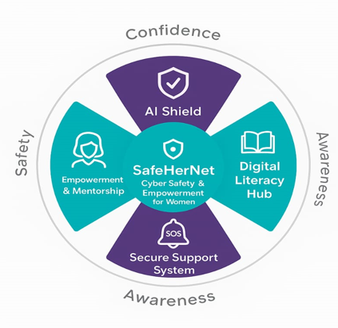
Introducing SafeHerNet
AI-powered Cyber Safety & Empowerment platform for women.
Women-first, human-centered design.
Combines advanced AI with mentorship & emotional support.
Goes beyond security—builds digital confidence.
Mission: Transform fear into leadership & empowerment.

Slide 3
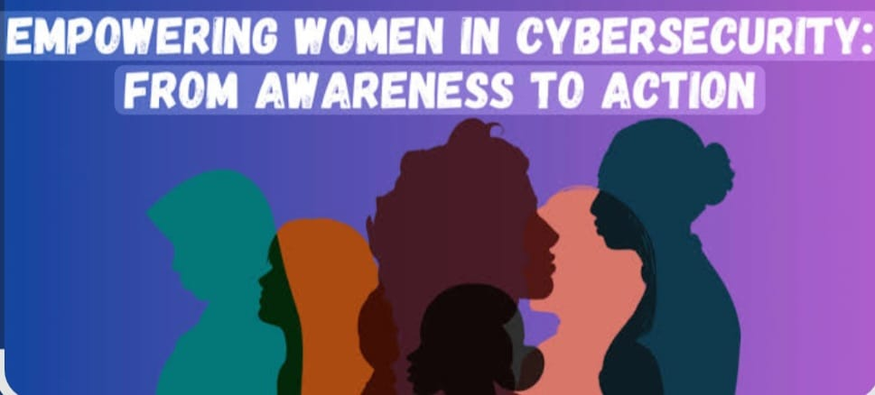
How SafeHerNet Works
AI Shield: Blocks phishing, scams, and deepfakes in real time.
Digital Literacy Hub: Gamified, multilingual AR learning.
Secure Support System: Anonymous reporting + SOS help.
Digital Footprint Visualizer: Control your exposed data.
Emotion-Aware Chatbot + Cyber Leader Network: Support & mentoring.

Slide 4
What Makes SafeHerNet Different
Women-centric design unlike generic tools.
Proactive defense—prevents harm, not just reacts.
Holistic: Safety, education, support & leadership in one.
Combines cutting-edge AI with empathy-driven features.
Builds confidence, not just blocks threats.

Slide 5
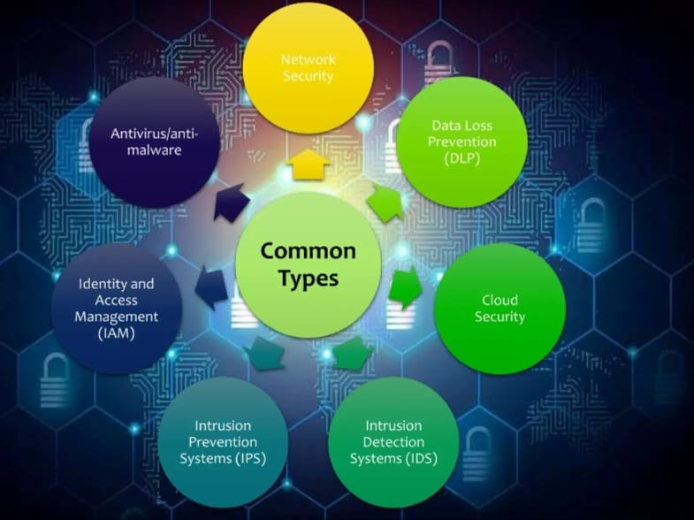
Real Stories, Real Need
Delhi student (2023) targeted by deepfake scam.
80% of women hesitate to report online abuse (Norton, 2022).
Cambridge Analytica exposed dangers of mass data misuse.
Rising cyber harassment limits women’s voices worldwide.
SafeHerNet directly addresses these urgent challenges.

Slide 6
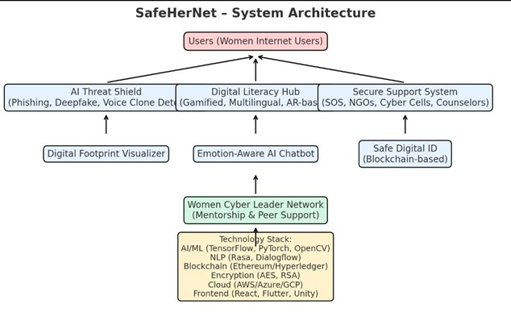
The Tech Behind the Vision
NLP Chatbot (Rasa, Dialogflow): Abuse & stress analysis.
Blockchain + AES/RSA encryption: Secure IDs & reporting.
Flutter/React + Unity/ARKit: App + gamified literacy.
AI & ML (TensorFlow, PyTorch, OpenCV): Threat detection.
Cloud + APIs (AWS, Azure, HaveIBeenPwned): Analytics dashboards

Slide 7
The Impact We Envision
Women feel safe, confident, and digitally empowered.
Encourages reporting without fear or stigma.
Builds resilience & awareness through literacy & support.
Creates future-ready women cyber leaders.
Vision: From vulnerable users → empowered changemakers.

